Slide 1
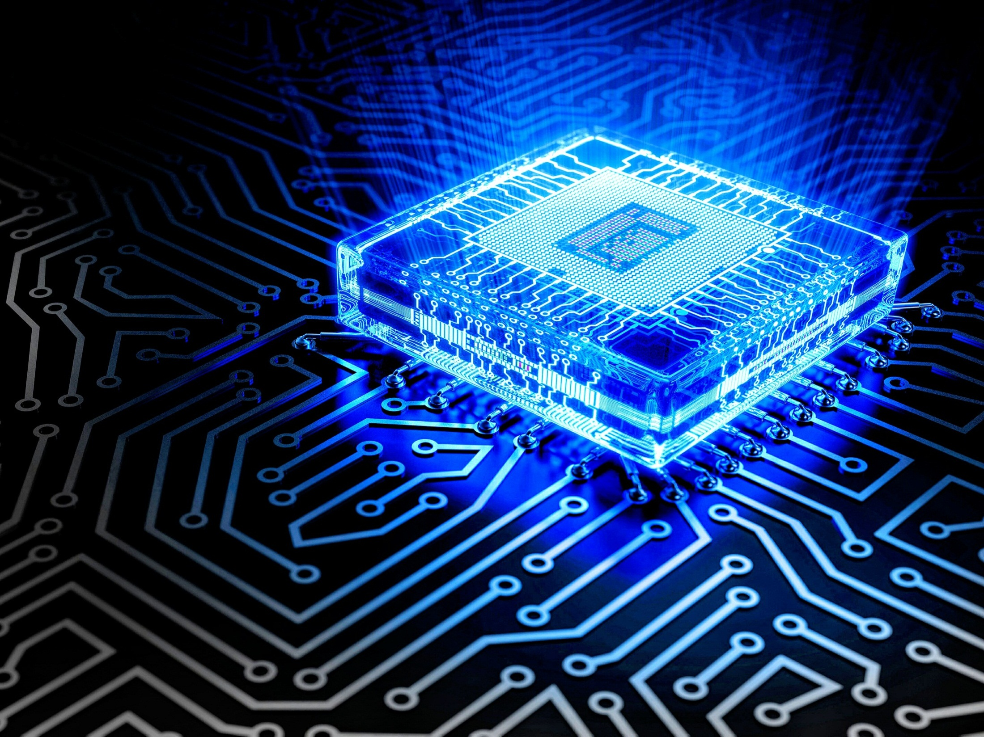

Semiconductor Physics(18PYB103J)
Module I – Lecture
4, 14, 15 & 16

Slide 2

Lecture 4, 14, 15 & 16 Topics
Influence of donors in semiconductor
Influence of acceptors in semiconductor
Non-equilibrium properties of carriers
Problem Solving

Slide 3
Extrinsic Semiconductors
When small quantities of selected impurities are added to an intrinsic semiconductor it becomes an extrinsic semiconductor.
Depending upon the type of impurity extrinsic semiconductors are of two types, namely
N – type semiconductor
P – type semiconductor.

Slide 4
Influence of donors in semiconductor
N – Type Semiconductors:
Generally, pure semiconductors have four valence electrons and can form four covalent bonds.
When a pentavalent impurity, say Phosphorus (P) which have five valence electrons is doped with pure Si, the four valance electrons of P is making covalent bond with 4 electrons of Si atom and one electron is left out alone.
This electron is present in the donor level which is lying just below the conduction band as shown in Figure.

Slide 5

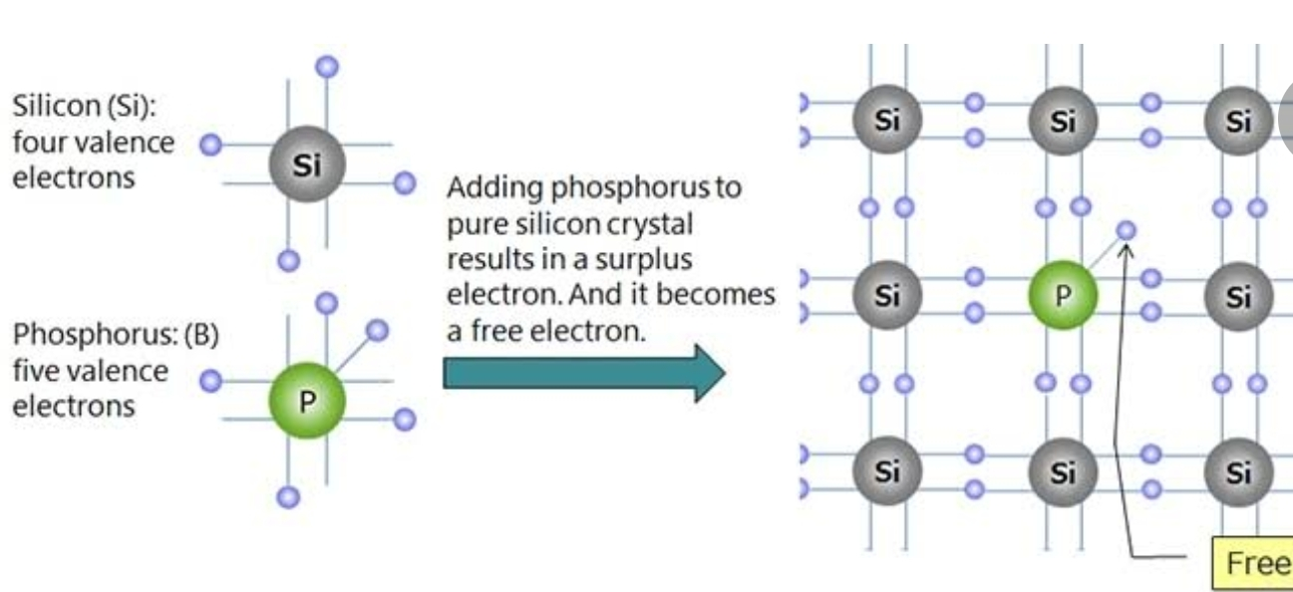
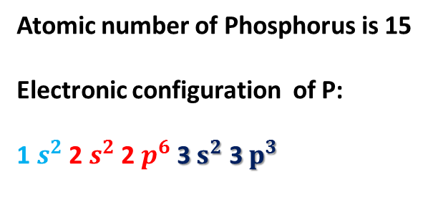
Extrinsic Semiconductor – N Type
Atomic number of Phosphorus is 15
Electronic configuration of P:
1 $s^{2}$ 2 $s^{2}$ 2 $p^{6}$ 3 $s^{2}$ 3 $p^{3}$

Slide 6
This energy level is called donor level and it is represented as Ed. Now the p atom is ready to ’donate’ this single electron.
When a small amount of energy is supplied, As donates the electron to the conduction band and become into positive ion.
In N - type semiconductor, holes are minority current carriers and electrons are majority current carriers.
Such type of semiconductor is called ‘N-type semiconductor’ or ‘DONOR’.

Slide 7
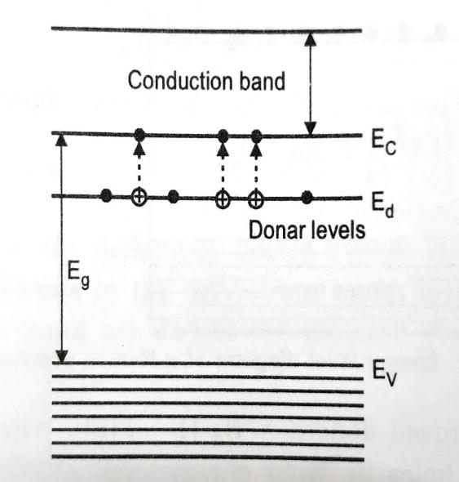

Slide 8
Influence of acceptors in semiconductor
P– Type Semiconductors:
When a trivalent impurity say Boron (which have three valence electrons) is doped with pure Si, the 3 valance electrons of Boron making covalent bond with 3 electrons of Si and the 4th electron of Si does not have a pair, so a ‘hole’ exists in Boron atom.
This means that Boron is ready to ‘accept’ an electron from Si to fill the hole. This hole is present in the donor level of
Boron atom which is lying just above the valance band as shown in Figure. This energy level is called as acceptor level and it is represented as Ea.
When a small amount of energy is supplied, the electron in the valance band move to the acceptor and the Boron become into negative ion.
In P - type semiconductor, holes are majority current carriers and electrons are minority current carriers. Such type of semiconductor is called ‘P-type semiconductor’ or ‘ACCEPTOR’

Slide 9
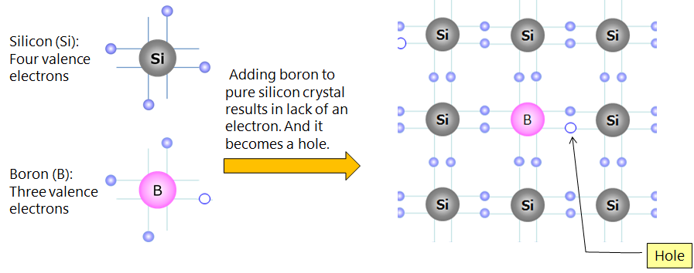
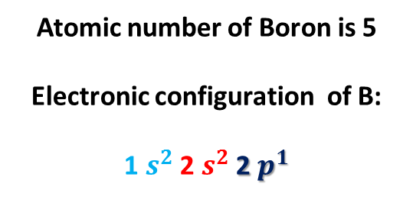
Extrinsic Semiconductor – P Type
Atomic number of Boron is 5
Electronic configuration of B:
1 $s^{2}$ 2 $s^{2}$ 2 $p^{1}$

Slide 10
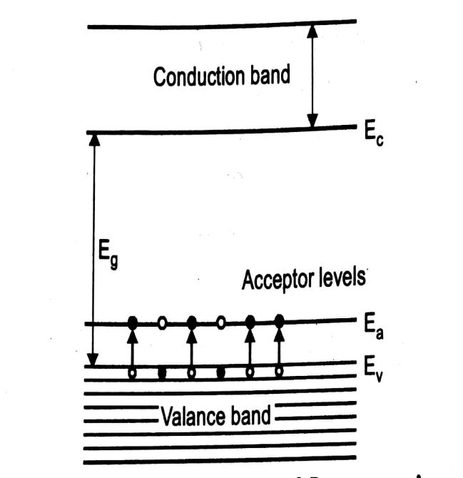

Slide 11
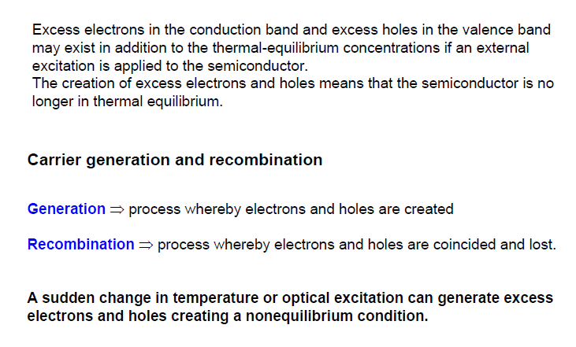
Non-equilibrium properties of carriers

Slide 12
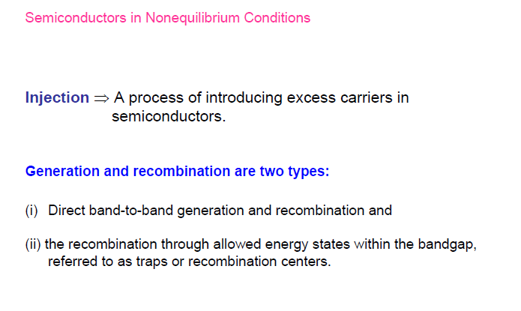
Non-equilibrium properties of carriers

Slide 13
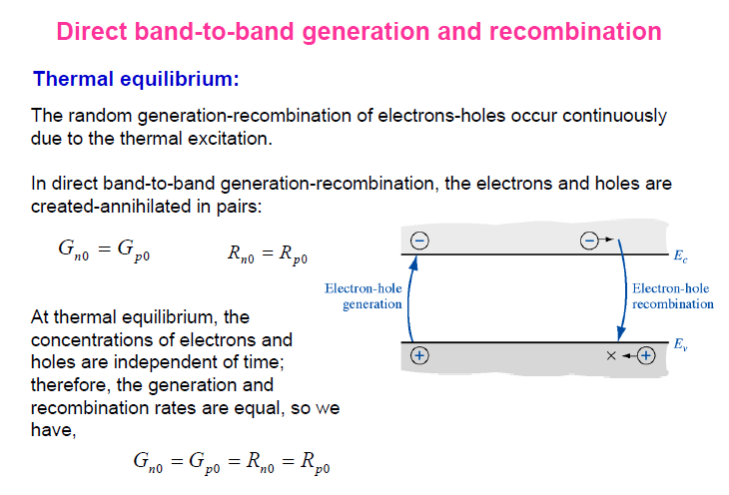
Non-equilibrium properties of carriers

Slide 14

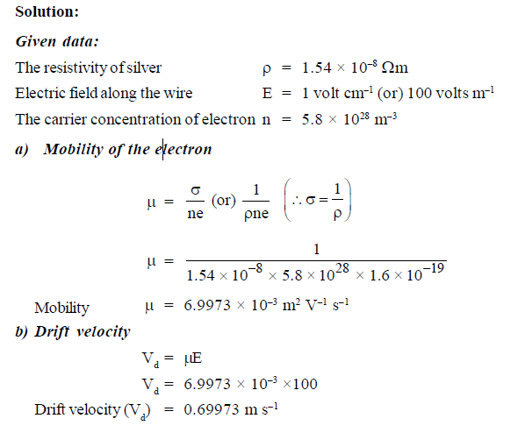
Problems
1.1 A silver wire has a resistivity of 1.54 ×${ 10}^{−8}$ ohm m at room temperature. For an electric field along the wire of 1 volt ${cm}^{−1}$, compute the mobility and drift velocity of electron. The number of conduction electron in Silver is 5.8 × ${10}^{28}$ $m^{−3}$.

Slide 15
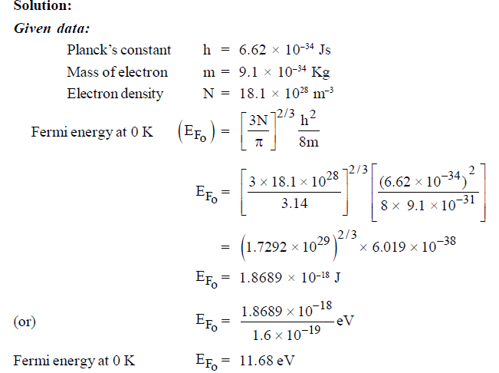
1.2. Free electron density of aluminum is 18.1 × ${ 10}^{28}$ ${ m}^{−3}$. Calculate its Fermi energy at 0 K.

Slide 16
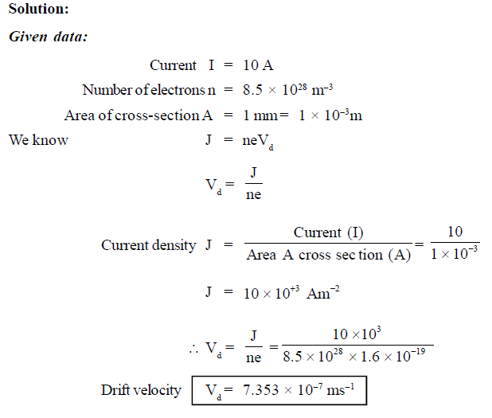
1.3. Find the velocity of copper wire whose cross-sectional area is 1 mm when the wire carries a current of 10 A. Assume that each copper atom contributes one election to the electron gas.

Slide 17
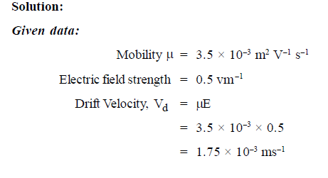
1.4. Calculate the drift velocity of the free electrons (with a mobility of 3.5 × ${ 10}^{−3}$ ${ m}^{2}{ V}^{−1}{ s}^{−1}$ in copper for an electric field strength of 0.5 V ${ m}^{−1}$.

Slide 18



1.5. Evaluate the value of Fermi distribution function for an energy kT above the Fermi energy.
Fermi distribution function

Slide 19
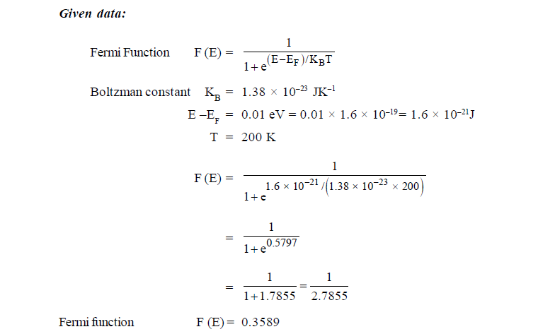
1.6. Use the Fermi distribution function to obtain the value of F(E) for
${ E−E}_{F}$ = 0.01 eV at 200K.

Slide 20
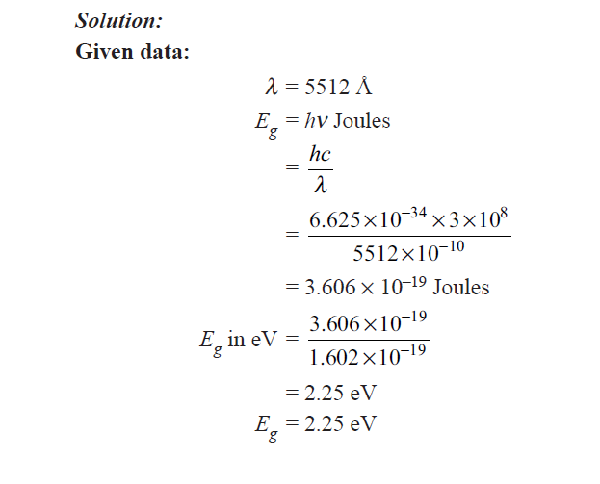
1.7. An LED emits green light of wavelength 5512 Å. Calculate the value of band gap in eV.

Slide 21
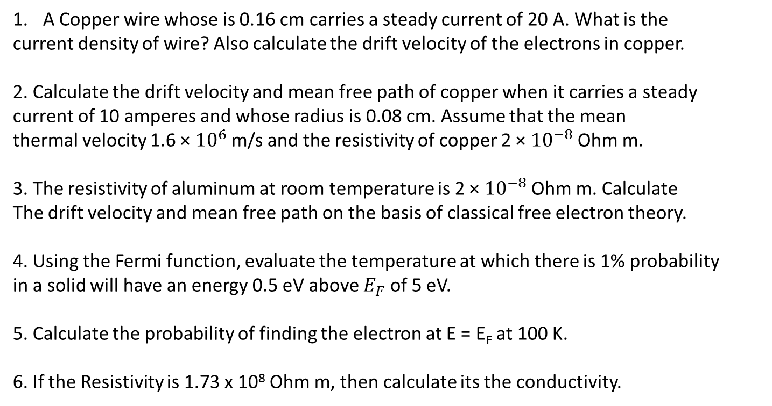
Assignment Problems
A Copper wire whose is 0.16 cm carries a steady current of 20 A. What is the
current density of wire? Also calculate the drift velocity of the electrons in copper.
2. Calculate the drift velocity and mean free path of copper when it carries a steady
current of 10 amperes and whose radius is 0.08 cm. Assume that the mean
thermal velocity 1.6 × ${10}^{6}$m/s and the resistivity of copper 2 × ${10}^{−8}$ Ohm m.
3. The resistivity of aluminum at room temperature is 2 × ${10}^{−8}$ Ohm m. Calculate
The drift velocity and mean free path on the basis of classical free electron theory.
4. Using the Fermi function, evaluate the temperature at which there is 1% probability
in a solid will have an energy 0.5 eV above $E_{F}$ of 5 eV.
5. Calculate the probability of finding the electron at E = E_{F} at 100 K.
6. If the Resistivity is 1.73 x 10⁸ Ohm m, then calculate its the conductivity.

